Slide 1


From MINnD Geotech to IDBE Geotech

Slide 2
MINnD Geotech Update
Mickaël Beaufils (BRGM)

Slide 3










MINnD Géotechnique (GT1-5) – The team
Addressing geotechnical data standardization
About 20 people (experts in geoscience, interoperability)
Teams meeting every Thursday 1PM
Owners
Constructors
Research / Public
Engineering
3

Slide 4
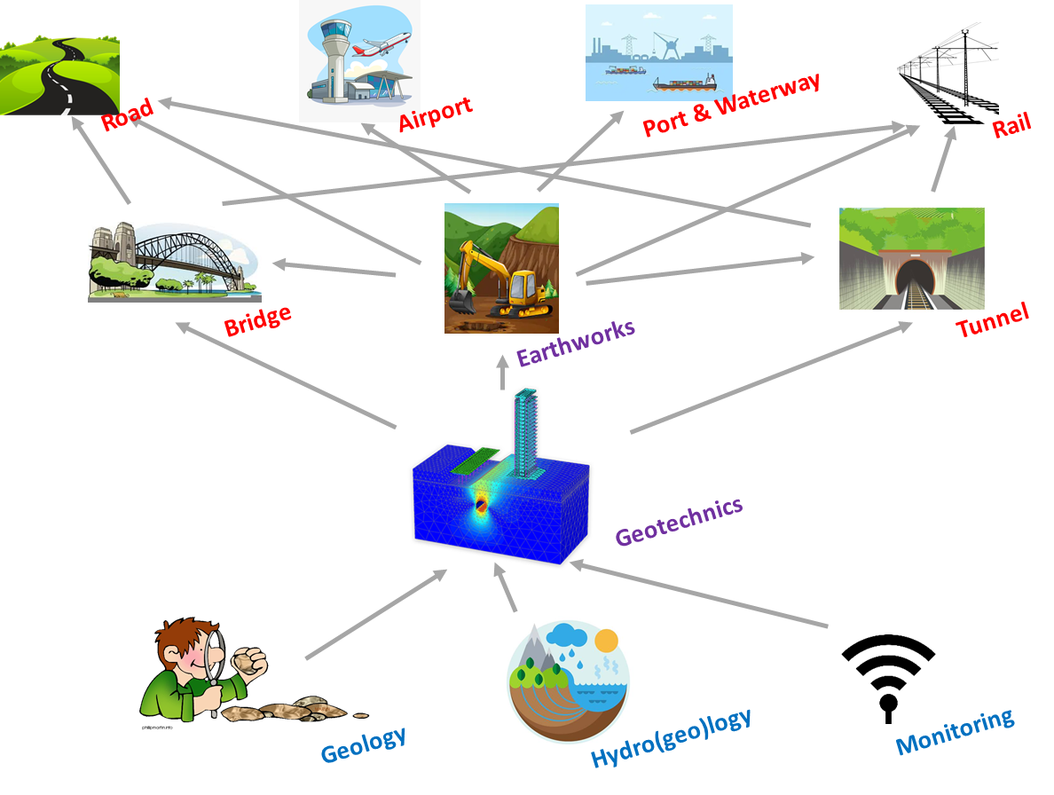
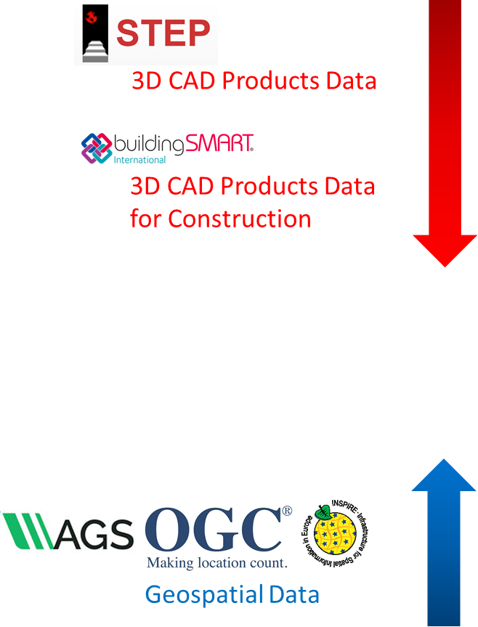
What is geotechnics?
The interface between geoscience and civil engineering
Get and interprete information about the soil / sub-soil in order to build sustainably
In France, the NFP 94500 define the geotechnical missions
How to address Geotechnics?
(and Earthworks)
4

Slide 5
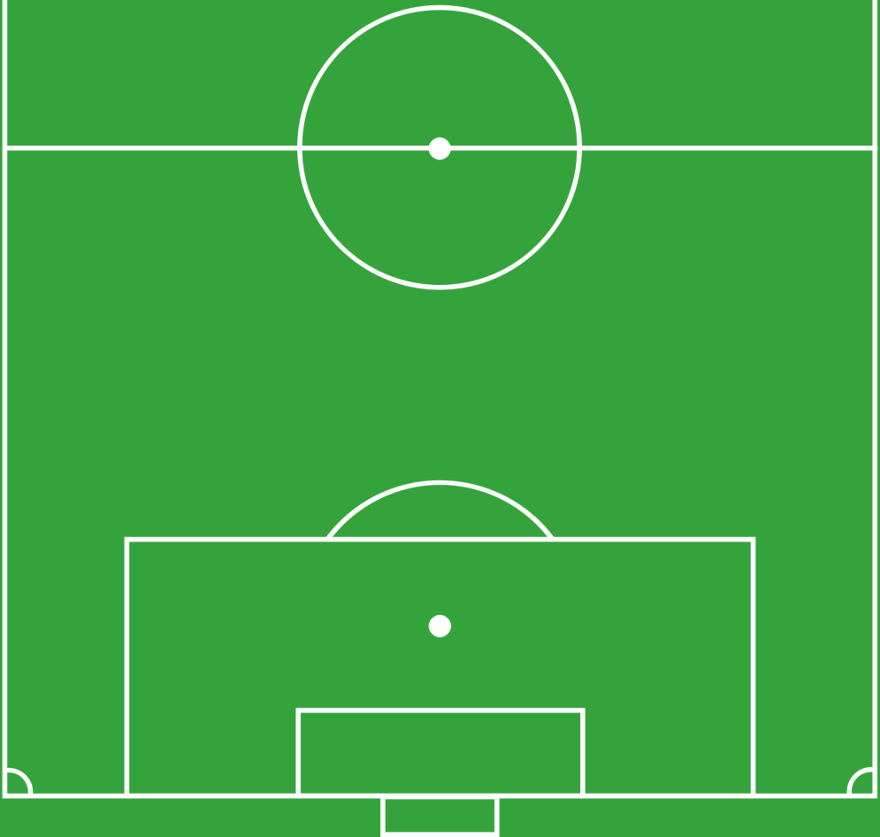
The geotechnical mission (NFP 94500 + AFTES GT32)
Designation | Id
Structure sizing and definition of the geotechnical influence zone | CALC
Construction methods | MECO
Geological modeling | GEOL
Hydrogeological modeling | HYDR
Geotechnical modeling | GTCH
Anthropic environment modeling | AVOI
Natural hazards and Pollution | NHPO
Observations and Measurements | RECO
Risk management | RISK
Book C:
Draft
Conception Plan
(including RISK)
MECO
CALC
GTCH
NHPO
AVOI
Book B:
Environment
Modeling
(including
uncertainties)
HYDR
GEOL
RECO
Book A:
Factual data
collection
RISK
5

Slide 6
#1 : The feature we represent and describe
Observation supports
Interpreted objects
Borehole
GeologicUnit
ShearDisplacement
Structure
Contact
OGC GeoSciML
OGC GeoSciML
OGC GeoSciML
OGC GeoSciML
Specimen
HydrogeologicUnit
FluidBody
FluidBodySurface
OGC O&M / ISO 19156
Sensor
OGC GroundWaterML2
OGC GroundWaterML2
OGC GroundWaterML2
Geotechnical Unit Continuum
« Soil like »
Geotechnical Unit
« Rock mass »
Matrix
DiscontinuitySet
Equivalent
Discontinuity
INSPIRE
Env. Monitoring Feature
Observed point
AFTES
Void
AFTES
AFTES
OGC GroundWaterML2
Observed zone
Exposed Elements
HazardArea
Existing construction
Natural Objects
Observations, Measurements and Interpretations
INSPIRE NaturalRiskZones
LandInfra / ISO 6707
Several data models
TypicalSection
(not necessarily tunnel)
Alignment
Geotechnical Infuence Zone
NFP 94500
NFP 94500
6
OGC O&M / ISO 19156

Slide 7
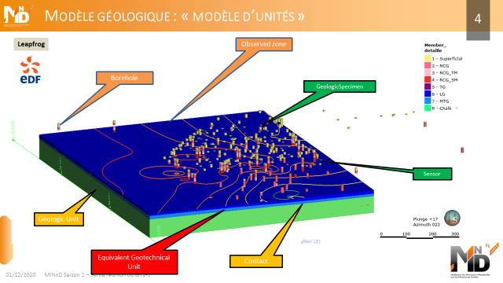
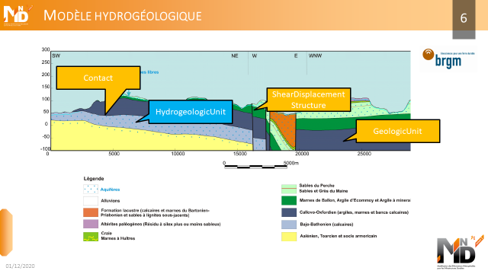
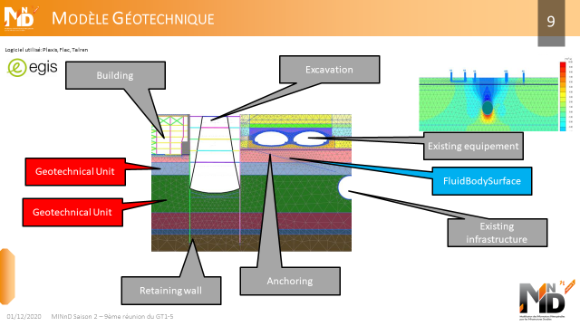
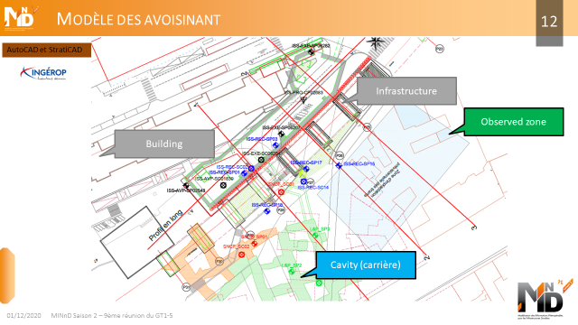
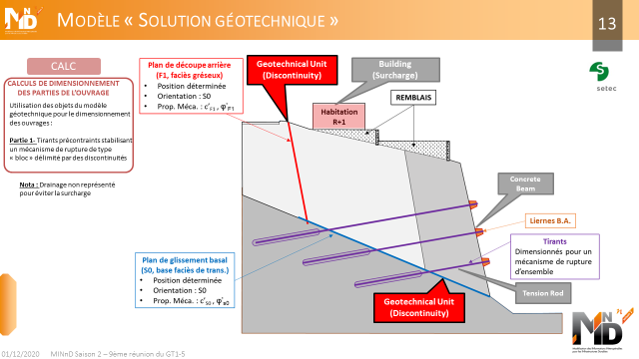
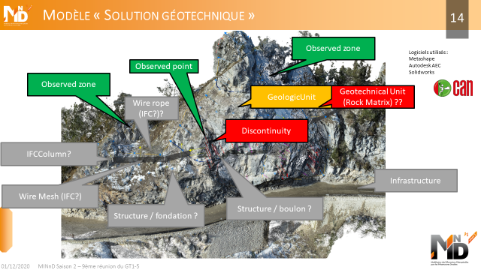
#1 : The feature we represent and describe
7

Slide 8
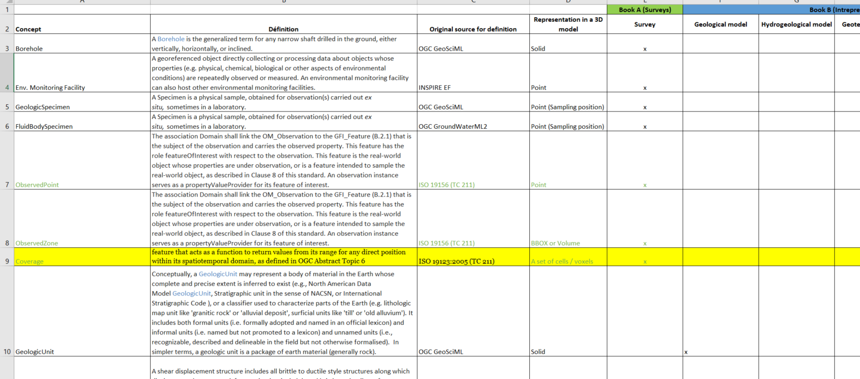
#1 : The feature we represent and describe
8

Slide 9
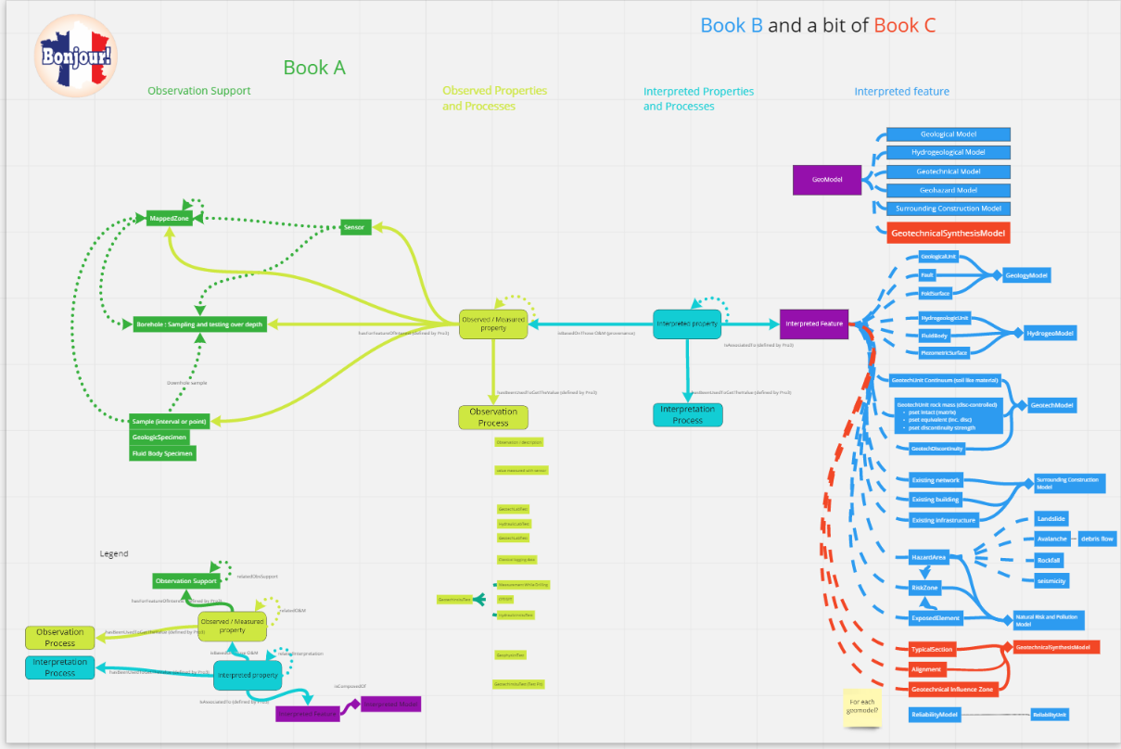
#2 : Relationship between objects and properties
9

Slide 10
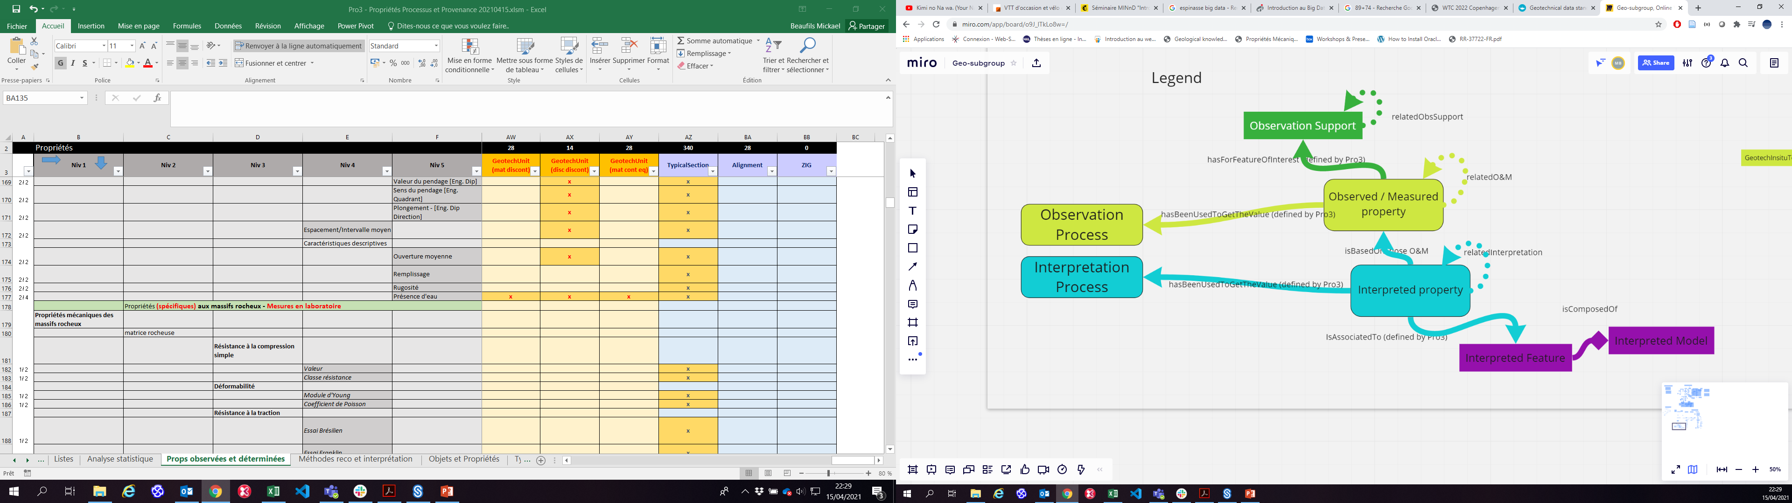
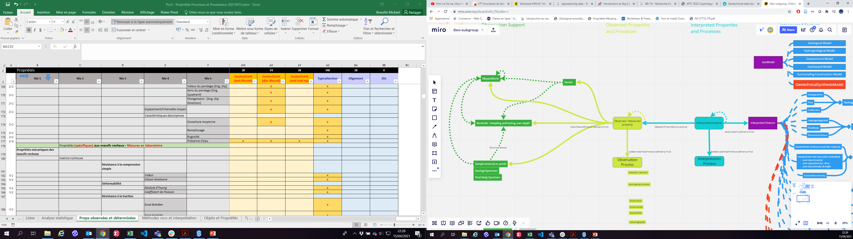
#2 : Relationship between objects and properties
10

Slide 11
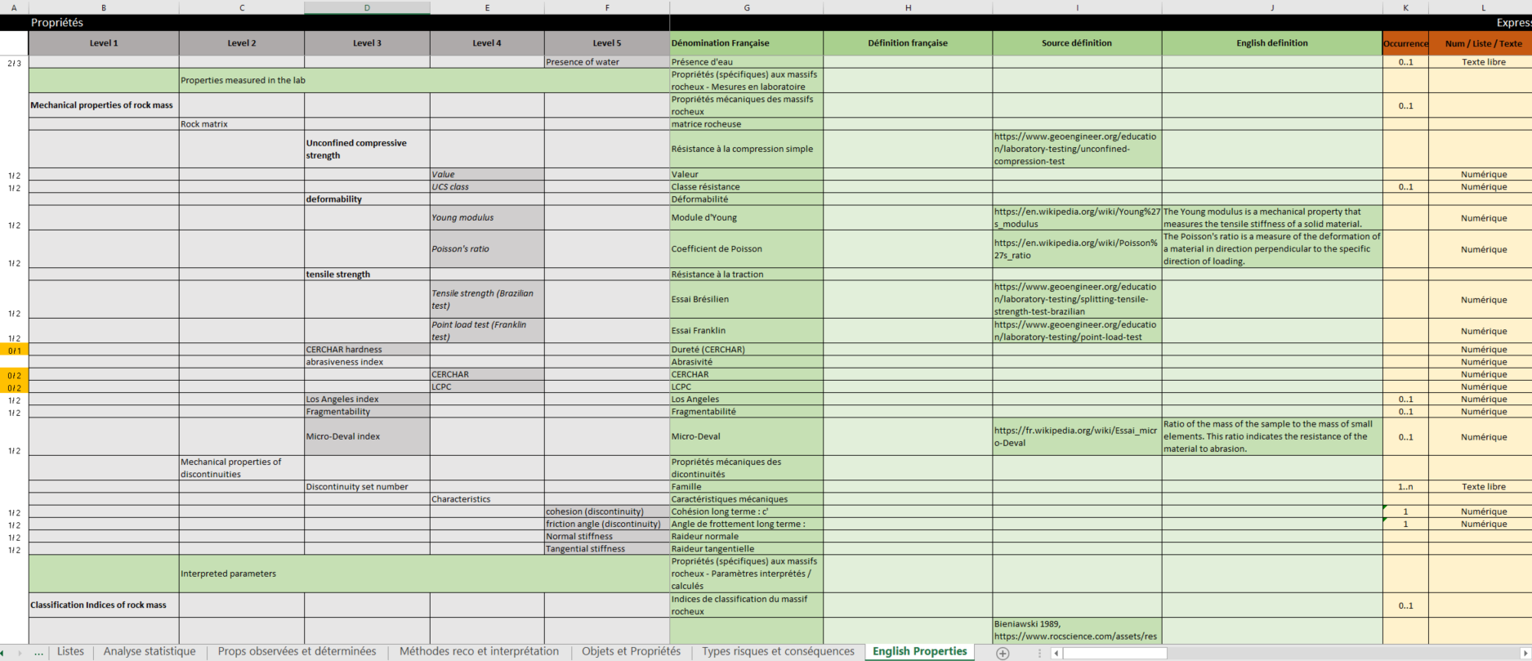
#3 : Vocabulary identification
Properties
11

Slide 12
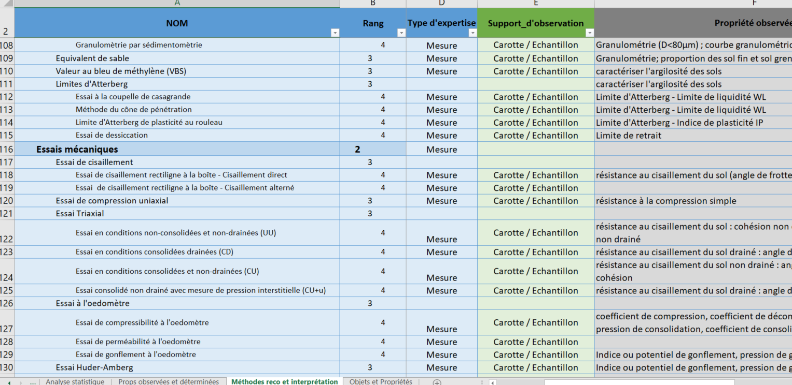
#3 : Vocabulary identification
Procedure
12

Slide 13
Participation to bSI IFC Tunnel Geo-subgroup
As member of MINnD
Four members from MINnD GT1-5:
Mickaël Beaufils & Isabelle Halfon (BRGM)
Sylvie Bretelle (GEOS)
Alexis Serieys (SETEC - TERRASOL)
Activities:
Regular members of the IFC Tunnel GeoSubgroup
Pushing the MINnD Geotech proposal
Connection with OGC
13

Slide 14
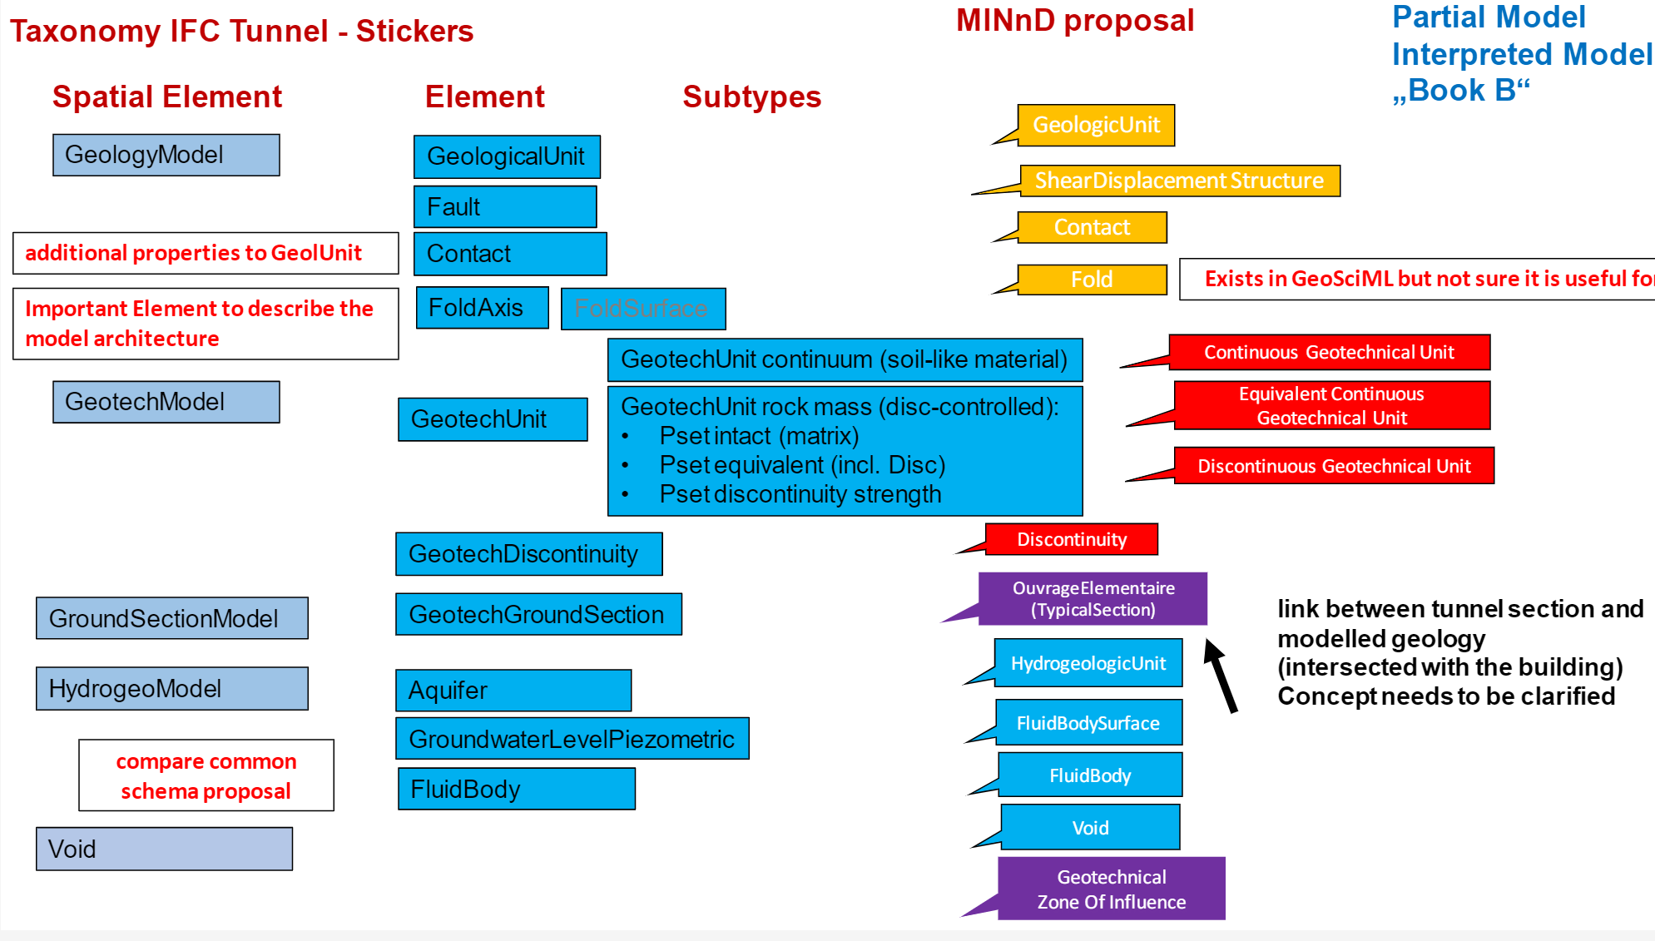
Participation to bSI IFC Tunnel Geo-subgroup: What MINnD GT1-5 provides
Source: IFC Tunnel GeoSubgroup

Slide 15
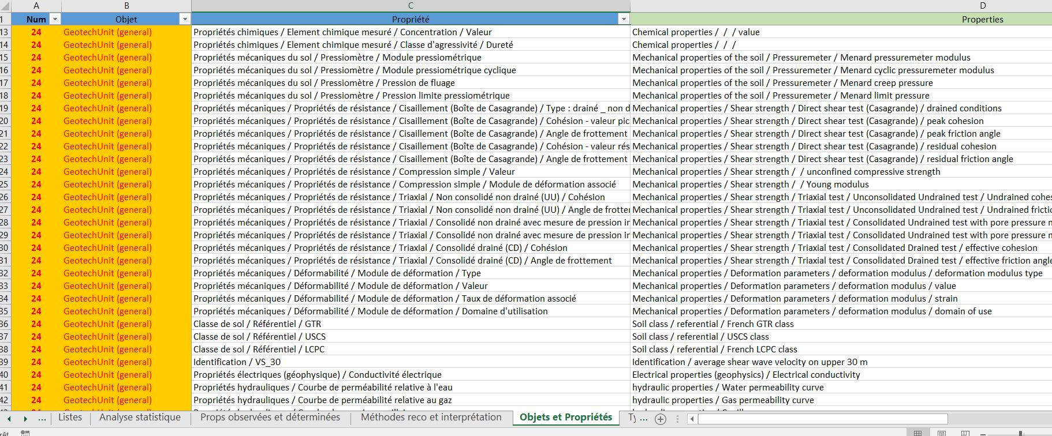
Participation to bSI IFC Tunnel Geo-subgroup: What MINnD GT1-5 provides
15

Slide 16
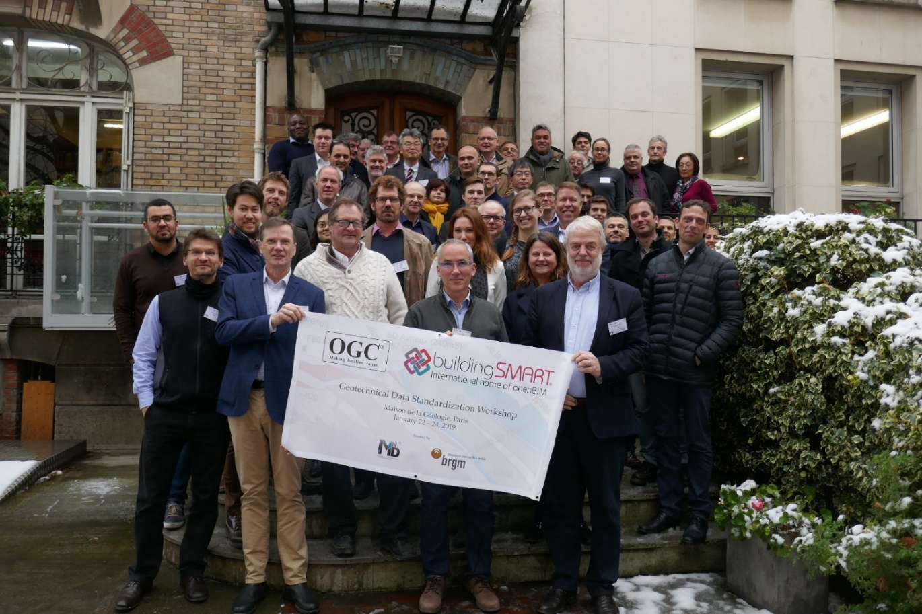
Communications
Done:
OGC TC Toulouse Nov 2019, Virtual Dec 2020
BIM World 2020
InfraBIM Open 2020
CFMS 2020
Submitted / planned:
BIM World 2021
InfraBIMOpen 2021
World Tunnel Congress 2022
16

Slide 17
Possible future: OGC + bSI collaboration
https://summit.buildingsmart.org/series/agenda52/schedule
See Thursday 18th, 1st session
46’30
17

